Slide 1
JASA Paper outline ;
Weekly Meeting (# 5)
TEA; PME; NTHU;
Good Afternoon Everyone
Microphone far-field array signal processing - Multiple Source amplitude and velocity estimation using Particle Filters.
Code Finalization and Simulation:
Prior Distribution included in weight update equation.
Comments added in the code.
Contour Plots for the desired and reconstructed normal surface velocity.
Comparison with MVU estimator.

Slide 2
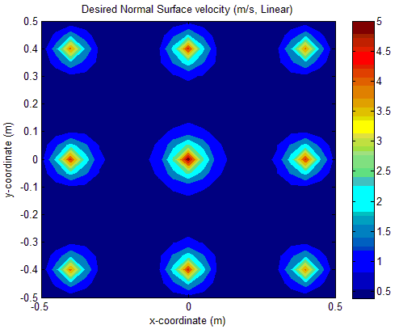

3*3 array of microphones at z = 0.
3*3 array of virtual sources at z = 0.4
Reconstrucion plane at z = 0.35 with 10 particles

Slide 3
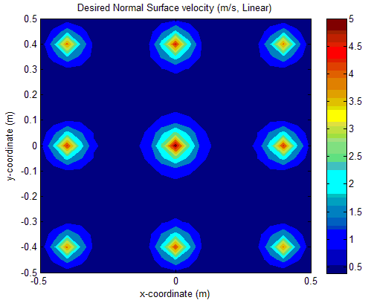
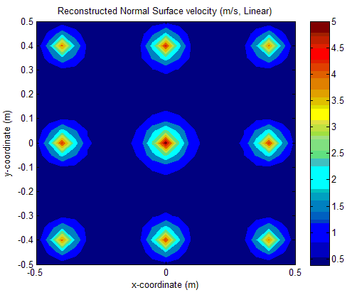
3*3 array of microphones at z = 0.
3*3 array of virtual sources at z = 0.4
Reconstrucion plane at z = 0.35 with 100 particles

Slide 4
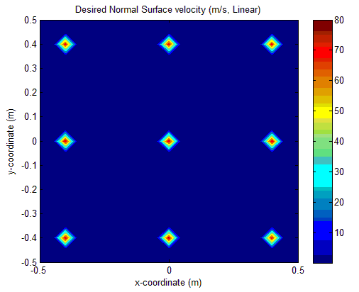
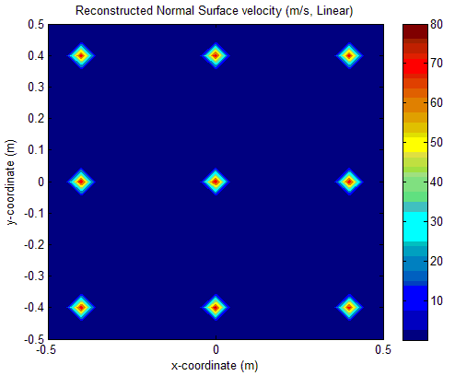
3*3 array of microphones at z = 0.
3*3 array of virtual sources at z = 0.4
Reconstrucion plane at z = 0.38 with 1000 particles

Slide 5
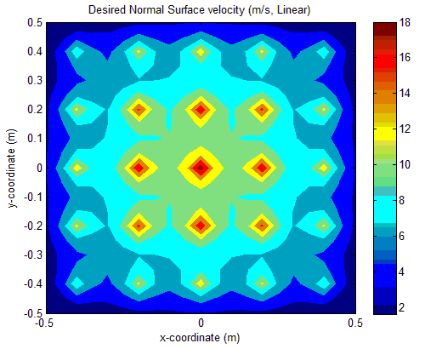
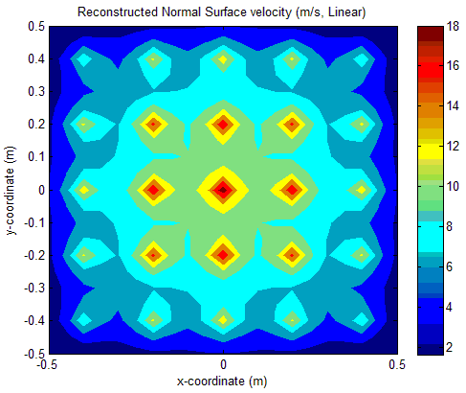
5*5 array of microphones at z = 0.
5*5 array of virtual sources at z = 0.4
Reconstrucion plane at z = 0.35 with 100 particles
TEA; PME; NTHU;

Slide 6
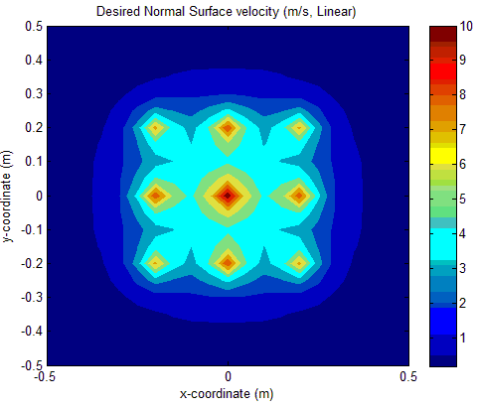

5*5 array of microphones at z = 0.
3*3 array of virtual sources at z = 0.4
Reconstrucion plane at z = 0.35 at 100 particles

Slide 7
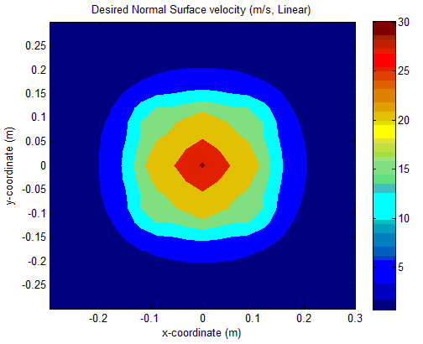
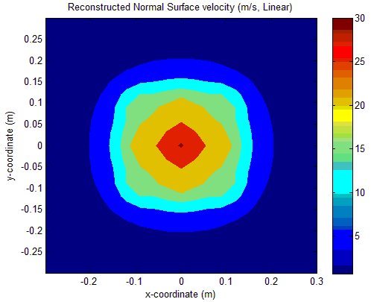
7*7 array of microphones at z = 0.
3*3 array of virtual sources at z = 0.4
Reconstrucion plane at z = 0.35 with 100 particles

Slide 8
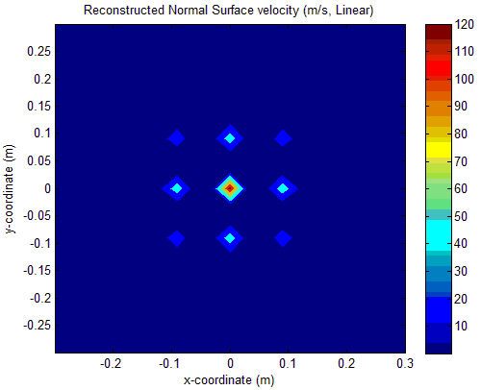
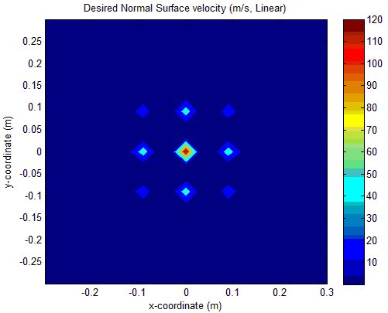
7*7 array of microphones at z = 0.
3*3 array of virtual sources at z = 0.4
Reconstrucion plane at z = 0.39 with 100 particles

Slide 9
Comments and Conclusions
The errors in each case were in the range of -0.3% to 0.3%.
The retreat distance plays an important role for the sources in reconstruction plane.
Variability in weights can be seen only if large number of particles are used. This also demands an optimal choice of the threshold sample size which is responsible for resampling.
Inclusion of prior distribution (taken as Gaussian with respect to source amplitudes) has resulted in decreasing the error bandwidth from 1.6% to 0.6%. However not much change was observed when prior was taken to be an uniform distribution.
The errors with MVU estimator are comparable and in some cases slightly higher as compared to those obtained from PF thus stressing upon the fact that PF is a better technique for parameter estimation.

Slide 10
JASA Paper Outline
Introduction
Signal Processing and Accoustics
Need for parameter estimation
Theoretical Background
Classical and Bayesian approach for parameter estimation
Particle Filter background and its advantages
How this problem can be fitted into particle filter framework
Problem Statement
Using Particle Filter as a tool for solving the problem
Simulation
Results
Conclusions
References

Slide 11
Things to do next…
Write JASA Paper.
If time remains:
Apply EM (Expectation maximization) algorithm to the same problem.
Treat the location of sources as random variables with Gaussian Distribution, include the appropriate prior distributions and estimate source co-ordinates in addition to amplitudes.

Slide 12
Thank you for listening

